Slide 1

Global Healthcare Workforce Imbalance
An Analysis of Doctor and Nurse Distribution
Ya-Jwu Jang 9015996
Naveen Sengamalam 8992493
Notes:
S25_INFO8677_sec2_Group1_Group Project
Aug 04 2025

Slide 2
Dataset Summary
This report presents a concise analysis of the global distribution and imbalance of doctors and nurses from 1960 to 2023, based on WHO Global Health Observatory data.
194
3.75
8.95
The total number of countries
Doctors
Nurses
Average Workforce Density
(per 10,000 population)
Africa
7.25
The parent location has the highest nurse-to-doctor ratio

Slide 3
Analysis Approach
4. Insights
Results were presented in a dashboard using Tableau
5. Recommendations
2. Prep the data
Provided recommendations based on insights obtained from the deep dive for implementation.
Download the two datasets, complete data cleaning, and exploratory data analysis using Python
3. Deep dive
1. The problem
analyzed global and regional healthcare workforce imbalances, focusing on doctor and nurse ratios.
Have a good understanding of the problem – “ Global Healthcare Workforce Imbalance” based on the WHO data

Slide 4
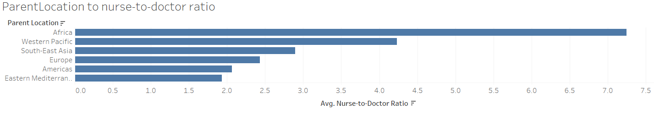
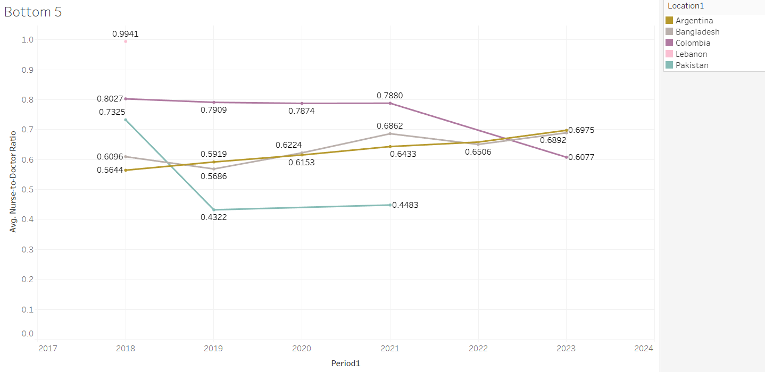
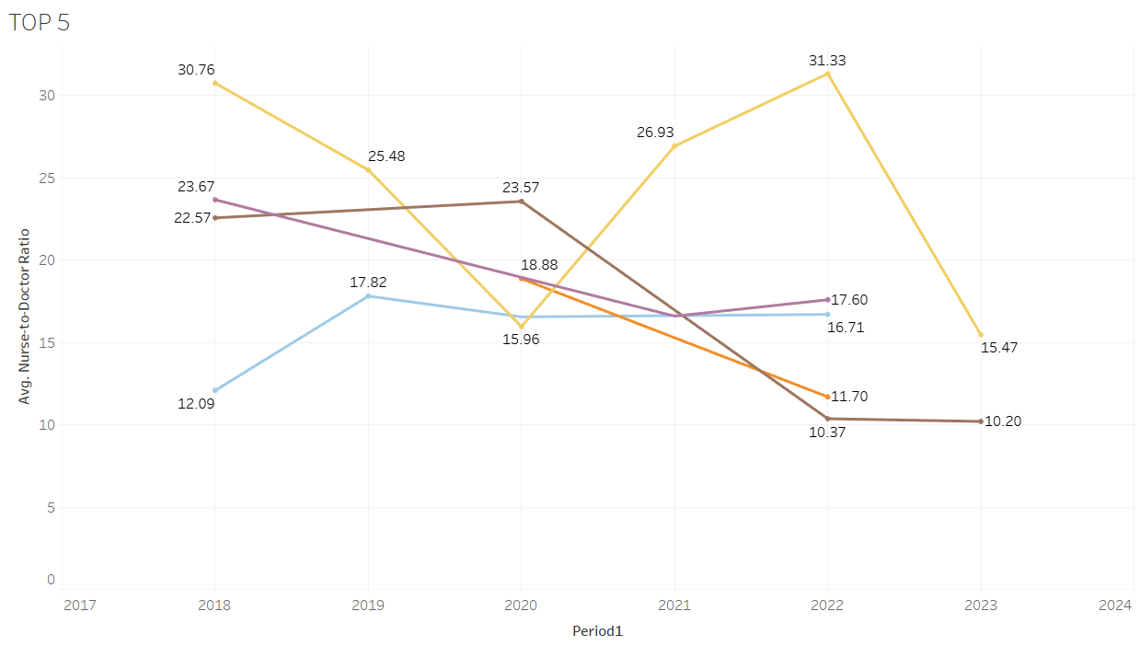
Key Insights
Regional Disparity in Nurse-to-Doctor Ratios
Divergent Trends in Nurse-to-Doctor Ratios (2018-2023)
Notes:
1. Regional Disparity in Nurse-to-Doctor Ratios
Insight: Significant regional gaps exist in average nurse-to-doctor ratios.
Finding: Africa has the highest average ratio at 7.25, indicating a substantial reliance on nursing personnel compared to other regions.
Divergent Trends in Nurse-to-Doctor Ratios (2018-2023)
Insight: Countries with high initial ratios show stable or increasing imbalance, indicating growing nurse dependency.
Finding: Low-ratio regions exhibit stable or slowly increasing trends, suggesting more mature healthcare systems.

Slide 5
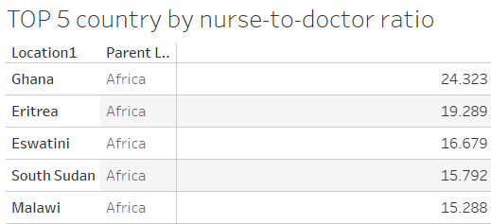
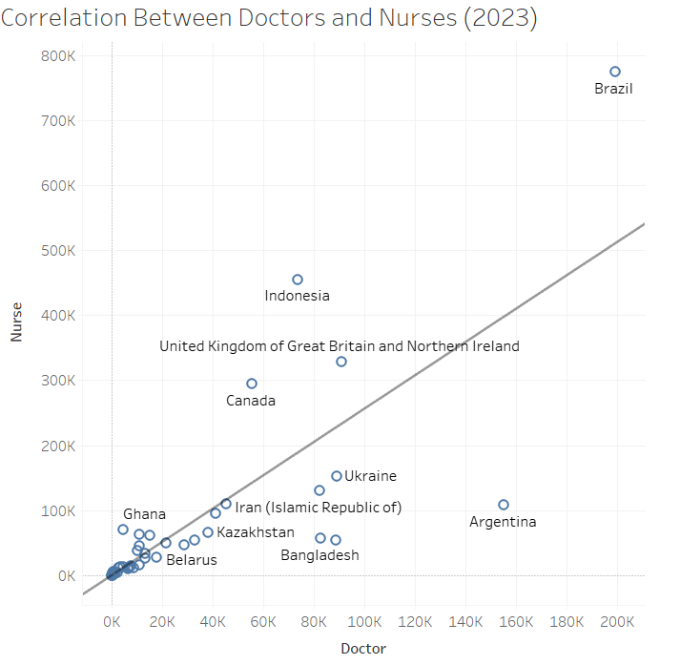
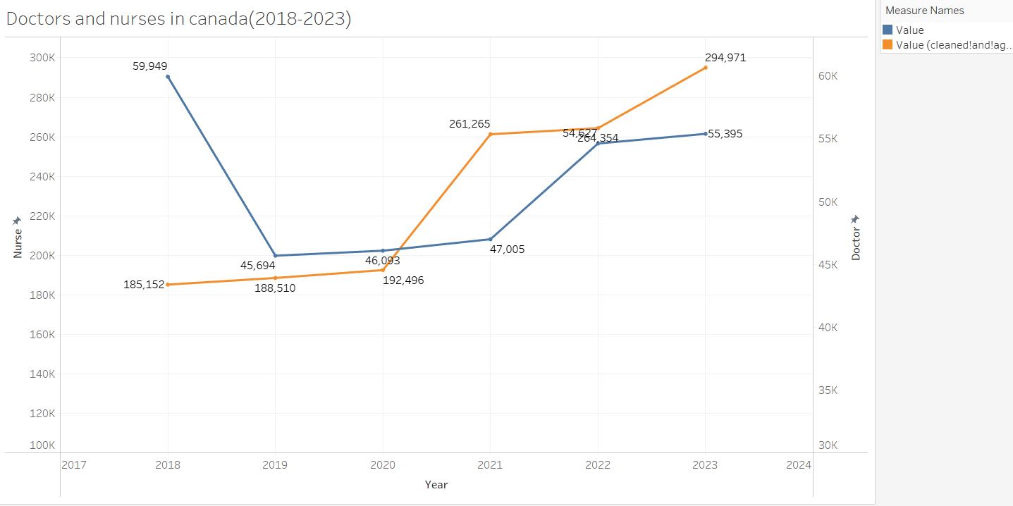
Key Insights
TOP 5 Countries by Nurse-to-Doctor Ratios
Correlation Between Doctors and Nurses (2023)
Doctors and Nurses in Canada (2018-2023)
Notes:
TOP 5 Countries by Nurse-to-Doctor Ratios
Insight: Countries with the highest nurse-to-doctor ratios are predominantly from Africa, confirming a strong regional pattern.
Finding: The top 5 countries (Ghana, Eritrea, Eswatini, South Sudan, Malawi) are all located in Africa, with ratios ranging from 15.29 to 24.32.
Doctors and Nurses in Canada (2018-2023)
Insight: Canada shows a significant increase in nurse numbers, while doctor growth is modest.
Finding: Nurses in Canada increased from 59,949 in 2018 to 294,971 in 2023. Doctors increased from 185,152 in 2018 to 264,354 in 2022, then slightly decreased to 55,395 in 2023. This indicates a growing reliance on nursing staff.
Correlation Between Doctors and Nurses (2023)
Insight: A positive correlation exists between doctor and nurse numbers globally, but with regional variations.
Finding: Higher doctor counts generally correlate with higher nurse counts, suggesting coordinated staffing. However, countries like Ghana (24,323 doctors, 19,289 nurses) show lower absolute numbers compared to developed nations like Canada (192,496 doctors, 261,265 nurses).

Slide 6
Recommendations
Targeted Investment in Doctor Training & Retention
Strategic Workforce Planning & Policy
Empower & Expand Nursing Roles
Foster Global & Regional Collaboration
Prioritize doctor training and retention in high-ratio regions (e.g., Africa) to prevent brain drain.
Implement data-driven national workforce plans for balanced doctor and nurse growth, regularly monitoring ratios for adaptive policy.
Invest in advanced training and expanded responsibilities for nurses, optimizing their utilization in doctor-shortage areas.
Encourage international partnerships and standardized data collection for robust comparative analysis and effective policy-making.

Slide 7
Appendix

Slide 8
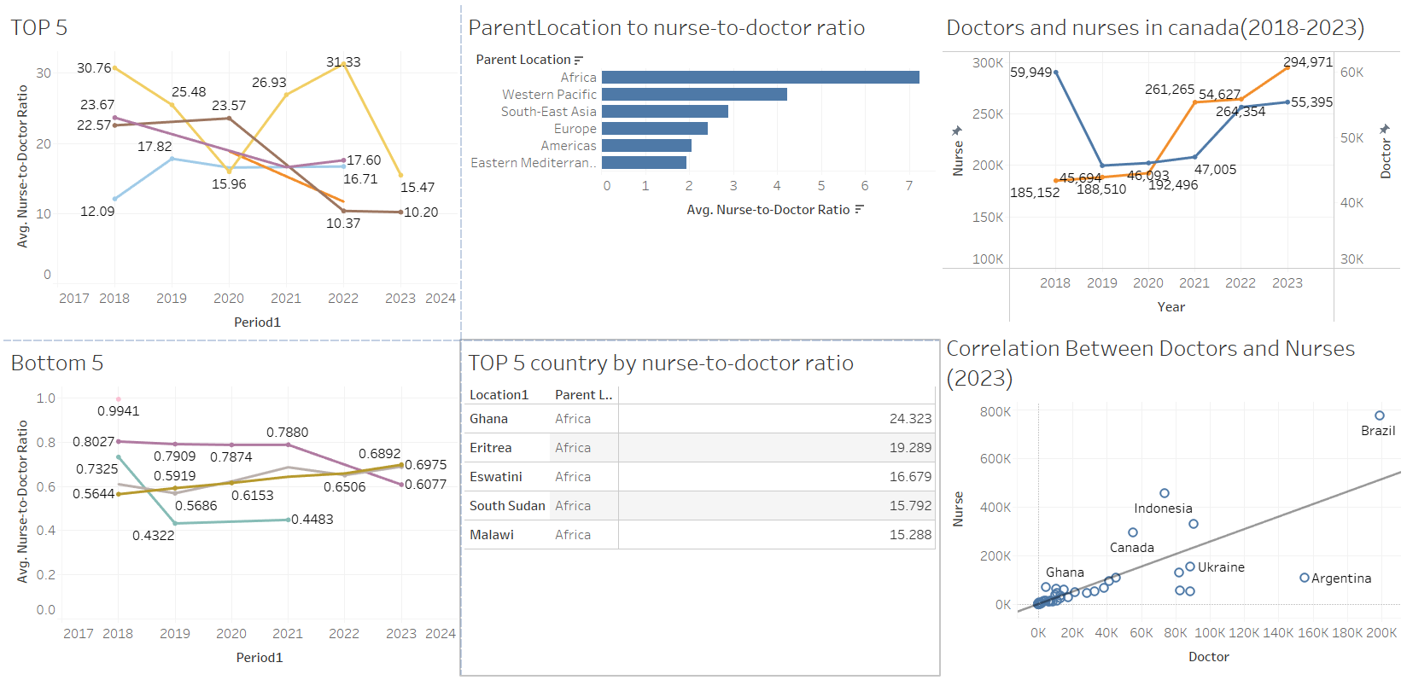
Appendix A Dashboard
Here you can give a brief description of the topic you want to talk about. For example, if you want to talk about Mercury, you can say that it’s the smallest planet in the entire Solar System

Slide 9
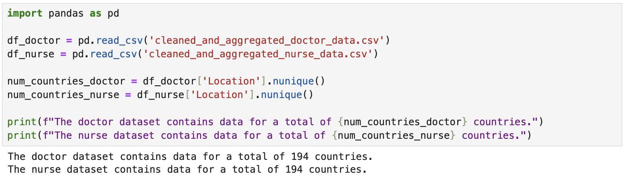
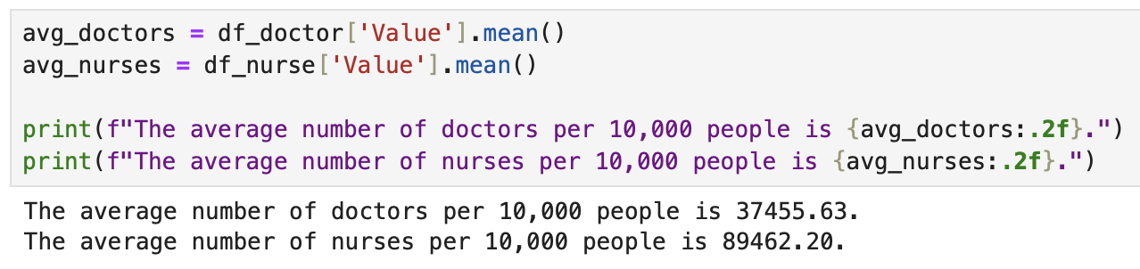
Appendix B Python Code
Obtain the total number of countries in the two datasets
Obtain the average number of doctors and nurses per 10,000 people
Here you can give a brief description of the topic you want to talk about. For example, if you want to talk about Mercury, you can say that it’s the smallest planet in the entire Solar System

Slide 10
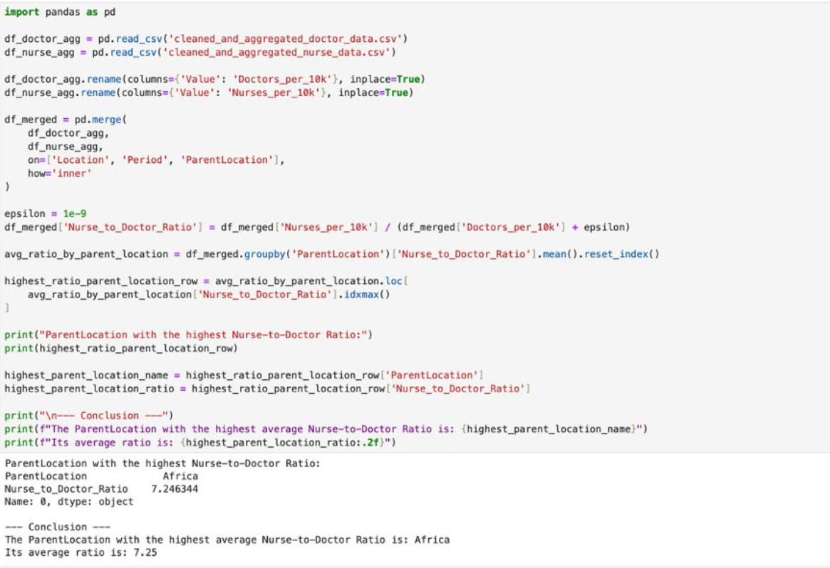
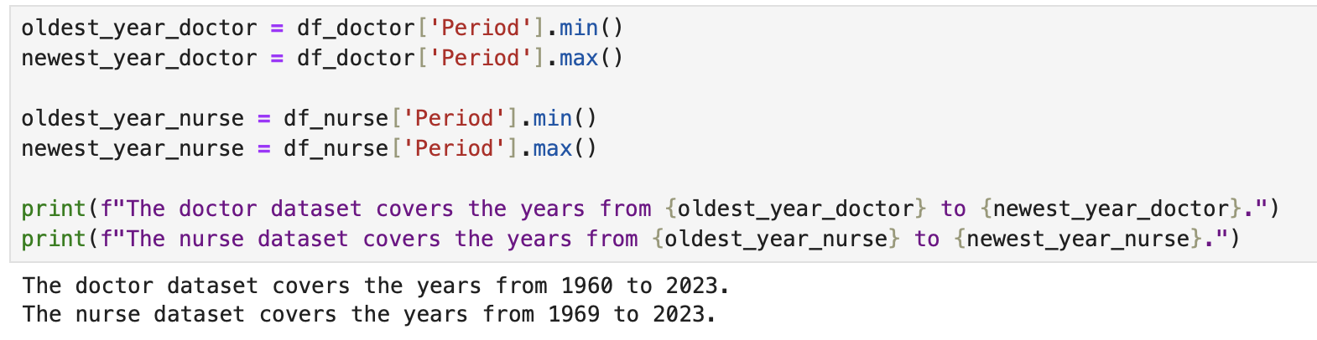
Appendix B Python Code
The Parent Location with the highest nurse-to-doctor ratio is Africa
Obtain the period of years in the two datasets
Here you can give a brief description of the topic you want to talk about. For example, if you want to talk about Mercury, you can say that it’s the smallest planet in the entire Solar System

